Slide 1

WSN Analytics
Dashboard
Automated Performance Analysis Tool for
Wireless Sensor Networks
Presented by
Janula Swetha | SE23UARI051
Jinukala Vaishnavi | SE23UARI054
Pavani Reddy | SE23UMCS020
NJ Madhav | SE23UCSE122
Notes:
1

Slide 2
OVERVIEW
What We Built
A full-stack Python application that collects, stores, analyzes, and visualizes Wireless Sensor Network (WSN) performance data — complete with interactive dashboards, SQL database, REST API, and automated PDF reports.
📊 Interactive Dashboard
🗄️ SQL Database
Streamlit-powered real-time visualization with filters
SQLite + SQLAlchemy for persistent sensor data storage
📡 REST API
📄 Auto PDF Reports
Flask-based API for external data access & integration
ReportLab-generated analysis reports on demand
TECH STACK: Python • Pandas / NumPy • Plotly • Streamlit • SQLite • Flask • ReportLab
Notes:
2

Slide 3
THE TEAM
Meet the Developers
📊 Janula Swetha
📈 Jinukala Vaishnavi
SE23UARI051
SE23UARI054
DASHBOARD & VISUALIZATION
DATA ANALYSIS & STATISTICS
• Streamlit dashboard design
• Plotly interactive charts
• Custom CSS theming
• Node health status UI
• Statistical analysis module
• PDR / latency thresholds
• Correlation heatmap
• Advanced analytics section
🗄️ Pavani Reddy
📡 NJ Madhav
SE23UMCS020
SE23UCSE122
DATABASE & BACKEND
API & REPORT GENERATION
• SQLite schema design
• SQLAlchemy ORM layer
• Data persistence logic
• CSV ↔ DB conversion
• Flask REST API endpoints
• PDF report automation
• ReportLab integration
• System integration & testing
Notes:
3

Slide 4
ARCHITECTURE
System Architecture
Sensor Data
(CSV Input)
Database
(SQLite)
Analysis
Engine
Dashboard
(Streamlit)
REST API &
PDF Report
▶
▶
▶
▶
50 nodes
pdr, latency,
energy, lifetime
SQLAlchemy ORM
Persistent storage
Pandas/NumPy
Stats & Thresholds
Plotly charts
Interactive UI
Flask endpoints
ReportLab PDF
Project Structure
dashboard_app.py
Streamlit dashboard with interactive controls & charts
database/db.py
SQLite ORM — save/query sensor data
analysis/analysis.py
Statistical computations: avg, std dev, variance, thresholds
reports/report.py
Automated PDF generation using ReportLab
visualization/plots.py
Plotly chart generators (histogram, scatter, radar, heatmap)
api/api.py
Flask REST API for external data access
Notes:
4

Slide 5
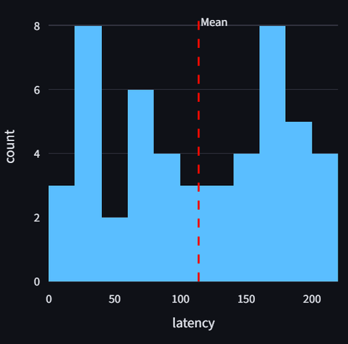
DASHBOARD
Janula Swetha | SE23UARI051
Key Performance Metrics
Avg PDR
Avg Latency
Avg Energy
Avg Lifetime
Health Score
0.806
113.8
2.68
565.6
65.62
ms
J
s
/100
Packet Delivery
Ratio
Network delay
across nodes
Energy consumed
per node
Estimated node
operational time
Overall network
health index
⚠ Active Alerts
Latency Distribution
Majority of sensor nodes show latency within the acceptable range, indicating stable communication performance.
21 nodes have LOW PDR
13 nodes have HIGH LATENCY
11 nodes have HIGH ENERGY
Notes:
5

Slide 6
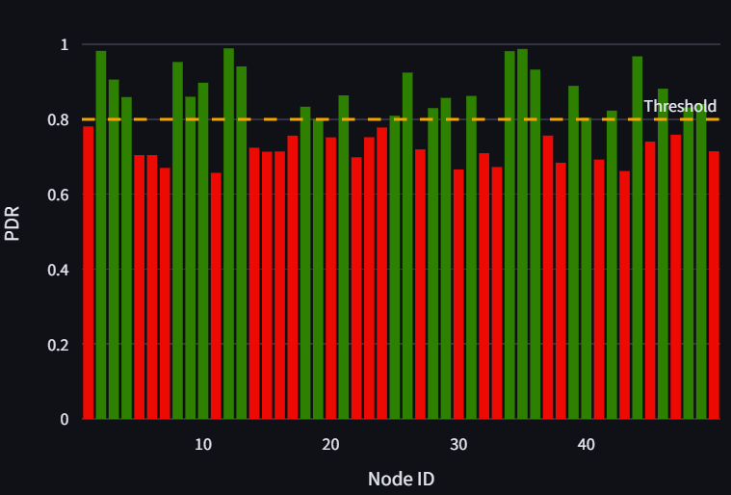
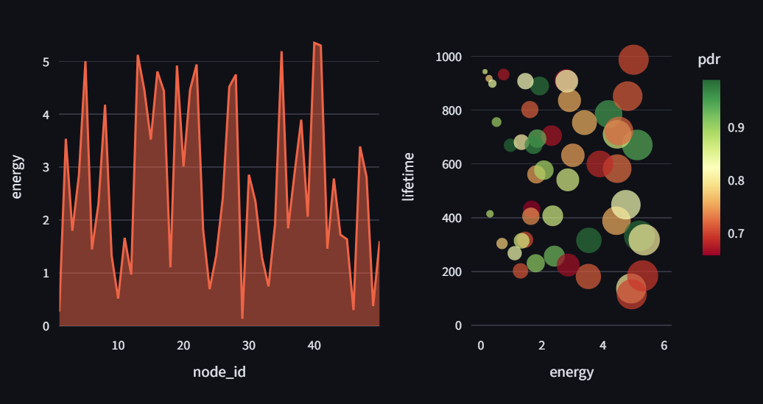
Data Analysis & Visualizations
Jinukala Vaishnavi | SE23UARI054
PDR Per Node
Energy Consumption
Energy vs Network Lifetime
Latency Distribution
PDR Per Node
Most nodes: 50–150ms. A few outliers above 150ms flagged as HIGH.
38% of nodes fall below 0.8 threshold — flagged as LOW PDR in alerts.
Energy vs Lifetime
Radar Analysis
Bubble chart reveals no strong linear relationship — energy usage varies widely.
Network balanced across Latency, PDR, Energy and Lifetime dimensions.
Notes:
6

Slide 7
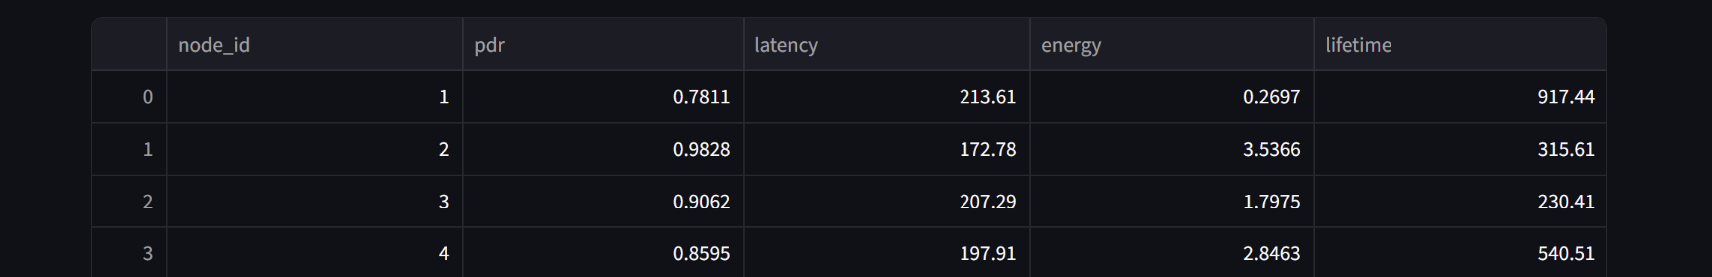
DATABASE
Pavani Reddy | SE23UMCS020
Database & Data Pipeline
SQLite Schema: sensor_data
Data Pipeline
node_id
INTEGER
Primary Key
1
Generate / Upload CSV
50 nodes, 5 columns of sensor readings
pdr
REAL
0.0 – 1.0
2
Load with Pandas
pd.read_csv() → DataFrame with validation
latency
REAL
milliseconds
3
Save to SQLite
save_to_db() via SQLAlchemy to_sql()
energy
REAL
joules
4
Query & Filter
Node range slider → SQL WHERE clause
lifetime
REAL
seconds
5
Export Filtered CSV
Download button for post-analysis use
Raw Data (first 4 rows):
Notes:
7

Slide 8
REST API & REPORTS
NJ Madhav | SE23UCSE122
API & Report Generation
Flask REST API
Automated PDF Reports
POST
/data
Network summary with avg PDR, latency, energy, lifetime
Submit sensor data as JSON array
Node health breakdown — healthy vs weak count
GET
/data
Retrieve all sensor records from database
Alert details: which nodes need attention
GET
/analysis
Returns statistical analysis results as JSON
Standard deviation & variance statistics
GET
/report
Generated using ReportLab — auto-saved to reports/
Download auto-generated PDF analysis report
# api/api.py — Flask endpoint example
@app.route("/analysis") → returns avg_pdr, avg_latency, health_score as JSON
generate_report(results) → saves analysis PDF to reports/report.pdf
Notes:
8

Slide 9
RESULTS
Key Findings
50
0.806
55%
65.62
Sensor
Nodes Analyzed
Average
PDR Score
Nodes
Healthy
Network
Health Score
Low PDR Issue
High Latency Nodes
42% of nodes (21/50) fall below the 0.8 PDR threshold — indicating packet loss. Likely due to distance or interference.
26% of nodes (13/50) exceed 150ms threshold. Average latency at 113.8ms — some nodes require investigation.
Energy Inefficiency
Weak Correlations
22% of nodes (11/50) have HIGH energy consumption. Poor lifetime correlation suggests sensor duty-cycle issues.
Heatmap shows near-zero correlations between metrics — each variable behaves independently in this dataset.
Notes:
9

Slide 10
CONCLUSION
Future Work &
Conclusion
Future Improvements
What We Achieved
🔴 Live IoT Integration
✅ Full pipeline from raw CSV to PDF report
Real-time MQTT data streaming into dashboard
☁️ Cloud Deployment
✅ Interactive Streamlit dashboard with filters
Deploy on AWS/GCP — accessible from anywhere
✅ SQLite database with ORM layer
🤖 ML Predictions
Predict node failure using historical patterns
✅ Statistical analysis (mean, std, variance)
📱 Mobile Dashboard
Responsive UI for field engineer use
✅ REST API for external data access
🔔 Real-time Alerts
✅ Automated alert detection & health scoring
Email/SMS when critical thresholds exceeded
Thank You • Janula Swetha • Jinukala Vaishnavi • Pavani Reddy • NJ Madhav
Notes:
10

